Slide 1
Data Science in Railway Traffic Control
Nisha Modani (66)
Avishkar More(68)
Sarang More(70)
Ashwini Nagare(81)
Guided By: Prof. Abha Marathe

Slide 2
Outline
What Is data science
Need of data science
Data science in track maintenance
Data Science In Train Frequencies Over A Time Period
Data Science In Train Accident Prevention
Recent application of Data science in Railways
Train Delay Prediction using data science
Future Scope of data science
Conclusion
References

Slide 3
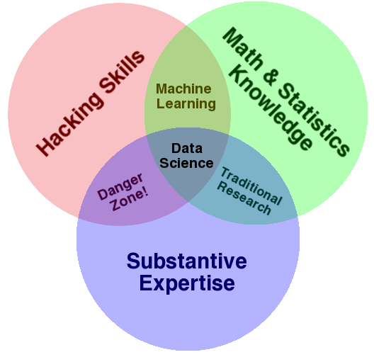
What is Data Science?
Multi disciplinary field
Use of tools for analysing raw data to discover any hidden patterns
Solving problems with data

Slide 4
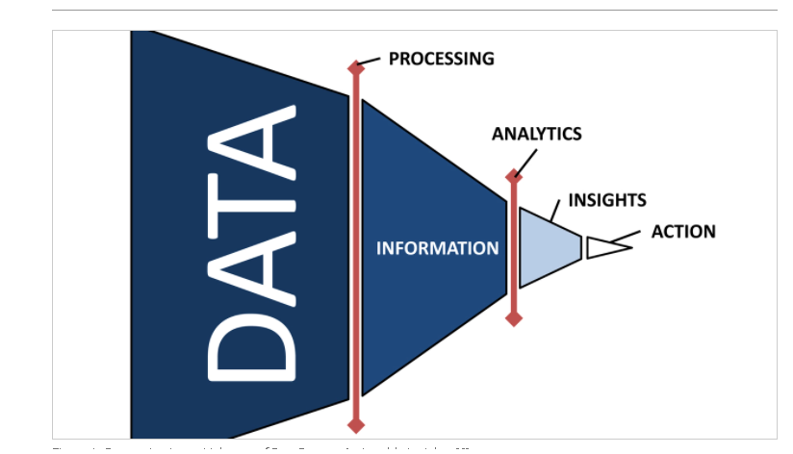
Need of data science in railways
To calculate the state of health of rail network
To identify critical areas in system and subsystem
To optimise network renovation
For passenger safety
To calculate predictive maintenance
To ensure dynamic and robust project performance

Slide 5
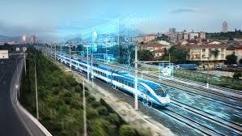
Data Science in rail track maintenance
Rail track data
Type of rail track faults
Rail inspection method and tool
Shallow learning based algorithms for rail track maintenance
Deep learning based algorithms for rail track maintenance

Slide 6
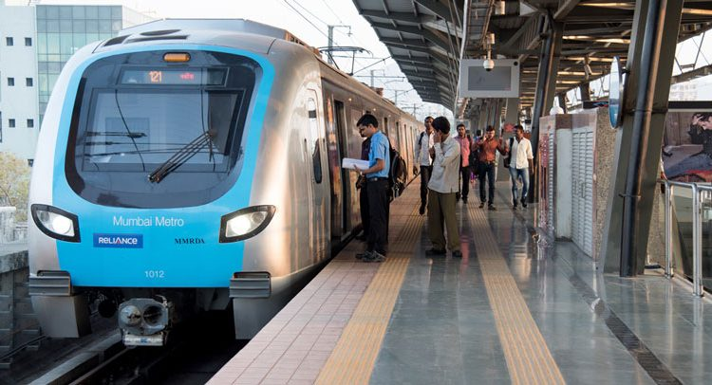
Data Science In Train Frequencies Over A Time Period
The Finance Minister of the Union Budget allocated Ministry of Railways -- Rs 72,216 crore in the annual budget in the year 2020.
Thus, trains have become an important part of human transportation over the years now, and so has data science as a unique branch which made an impact on tracking the population that uses this mode of transport.
Data Science can keep track of the number of arriving and departing trains as well as the number of people travelling in these trains.
If, for an example, an average number of passengers travelling throughout a week is calculated by the railways department, it gets an estimate of how many people travel by trains in a day, which may help the department keep track of future advancements or improvisations in service of the trains.

Slide 7
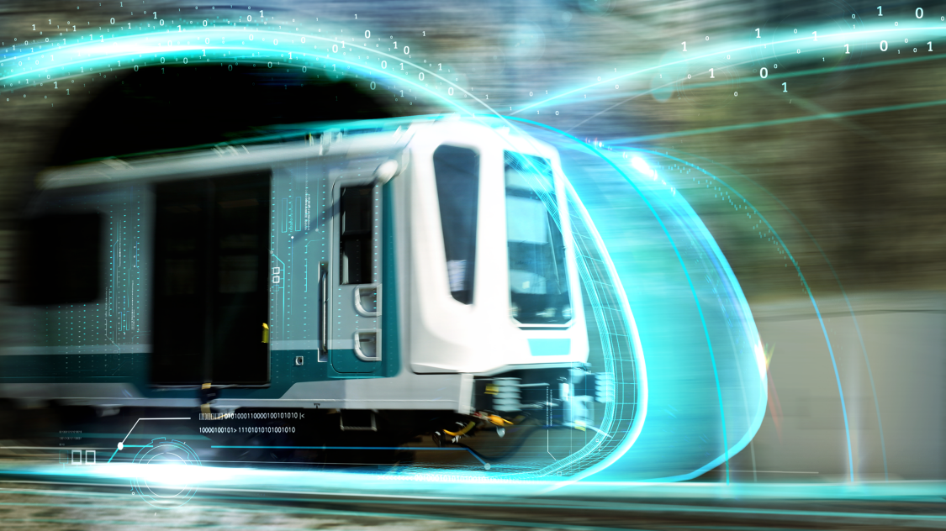
Like, if the department gets to know through analysis that the number of passengers travelling in a day from Pune to Mumbai local trains is around 1,500, then it can make an estimate of number of seats required for the whole population in a train or even a small compartment.
These numbers can also help in the estimation of number of trains that need to be dispatched from Pune to Mumbai in a single day., which will evenly distribute the amount of population to the number of trains.
This survey can help in further management of the total sum of crores of Rupees allocated to the Railways Ministry.

Slide 8
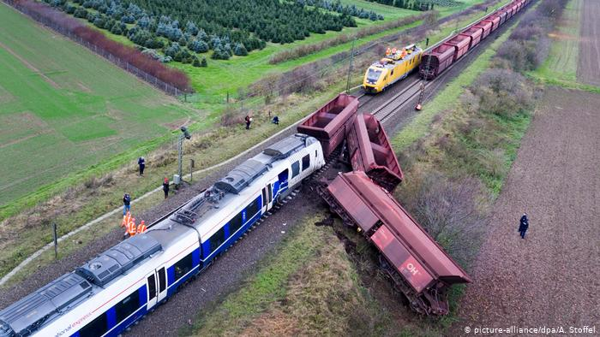
Data Science In Train Accident Prevention
Data Science, being a master of data analysis and prediction of given parameters or units, can also be used as a life-saving measure by the railway industry.
This decisive field can be used to prevent accidents of trains, which involves immediate course of action, insightful thinking and also, some critical calculations.
As we know, data science can keep track of the train speed and object distance, it can prove vital in train accident close-calls.

Slide 9
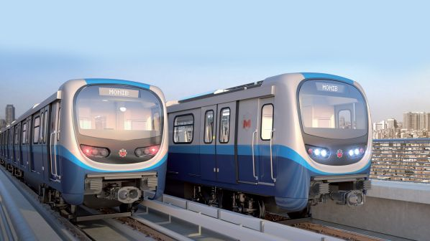
Like, if we consider an example of two trains travelling in the same direction, the trains’ speeds can be kept in account and the fact that they are at a safe distance from each other.
If at all, the working of Train 1, which is ahead on the tracks, stops due to technical failure, the Train 2’s distance is taken into account and time also plays a pivotal role if the Train 2 is not at a safe distance from Train 1.
Parameters like time , train speed, braking efficiency, frictional control, distance, and many more are taken into consideration for crucial and at the same time quick decisions for stopping of fatal accidents.

Slide 10
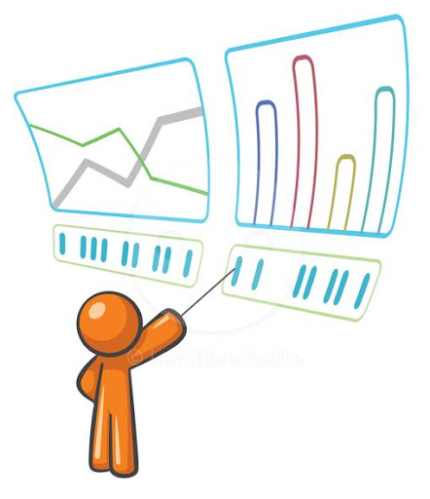
If the on-the-spot analysis of graphical data and actions like sudden braking or immediate lowering of speed are performed right away.
This can actually prevent the causing of an actual accident at the meeting point of two trains.
If it is too late for the latter train to brake before it appears at the rear point of the former, a fully calculated track change action can also prove useful for the prevention of a devastating fatality.

Slide 11
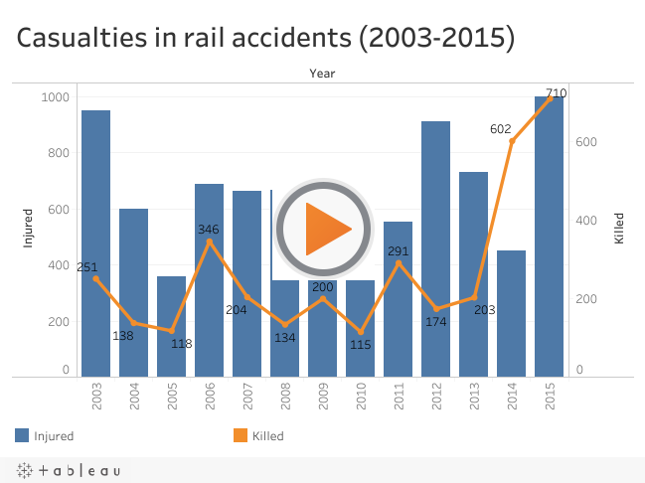
This is how Data Science can prove to be useful in railway accident control.
If we think of a more suggestive and analytical data tools to be put in the working of such operations, we can think of using charts and graphs for tracking death rate of population with suggestive measures for the prevention of deaths.
If possible, we can also set particular range of speeds for each and every train travelling from one place to the other.
So, even if a train exceeds it’s speed limit, the tools can help a control station analyse and predict the prevention of an accident and it can be easily conveyed it to the train driver.

Slide 12
Recent application of Data science in Railways
Booking Tickets
Emergency train route changes
Food Catering for the passengers.
Travel schedule of a train.

Slide 13
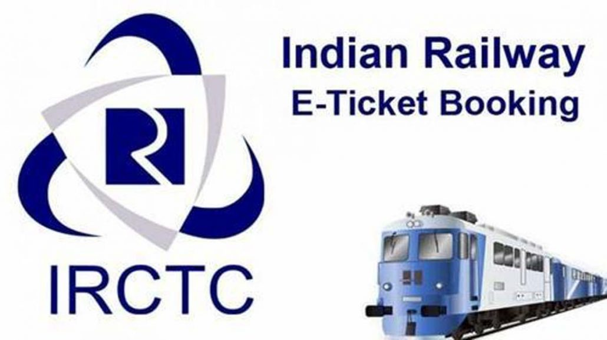
Ticket booking
Most of us would be acquainted with the e-ticketing portal ‘IRCTC’ of the Indian Railways.
Earlier the site would get paralyzed as soon as the clock ticked 10.
But that’s not the case now. IRCTC which books 13 lakh tickets per day at an average, has not only improved its speed but also the way it serves its customers.
These improvements have been possible because of the use of Big Data Analytics.
Determining the frequent travellers, same train travellers, long route travellers and more using analytics has helped Indian Railways service

Slide 14
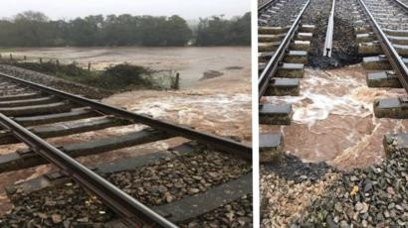
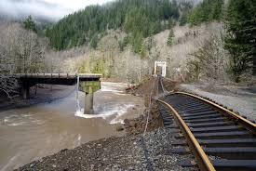
Emergency Train Route Changes
In case of a landslide, a flood or a emergency track repair, the system can automatically reroute a new path of the train travelling on that damaged track.

Slide 15
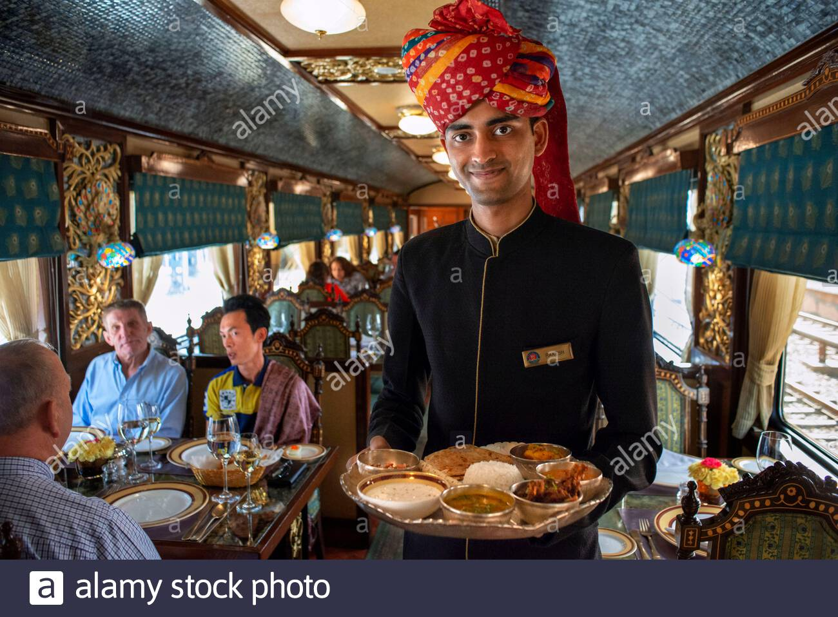
Food Catering For Passengers
Considering the huge number of long distance passengers that Indian railways serve each day, catering food is an important part.
But to serve better the choice of food must change w.r.t area. Moreover the cost of food is also a matter of importance.
Big Data Analytics can be used to cater food at reasonable rates at the same time making it profitable for the catering department.
Analytics can also be used to expel out the unnecessary cost that has been a concern for the catering department of Indian railways.
Moreover it can help in better servicing at relevant locations when the train gets delayed.

Slide 16
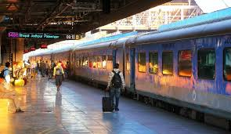
Travel Schedule For The Train
Time interval between arrival and departure of train at a particular station can be managed.
Depending on data collected regarding crowd of passengers we can also decide stations covered by particular train.
The system can also manage the time the train stops at a particular station.

Slide 17
Train Delay Prediction
Many times trains are delayed
Factors affecting train timings are:
Weather conditions
Track conditions
Riots, strikes, rallies, etc.
Data analysis is done from following data collected:
Historical train delay data
Weather forecasting data

Slide 18
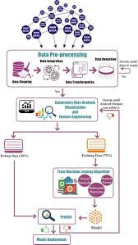
Train delay prediction process
Historical data for train delays is collected
Weather data is collected
Exploratory data analysis is done
Feature engineering to decide algorithms
Algorithms that are generally used:
Extreme learning machine
Random forest
Whole data set divided into training and testing data set
Functions are produced to map new values

Slide 19
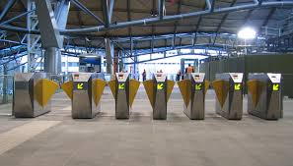

Future Scope
Data science can be used to keep in control use of resources such as:
Number of ticket counters can be reduced or increased depending on need
Number of entry exit gates in metros can be managed
Number bogies can also be increased or decreased with help of data collected on basis of crowd
In order to increase revenue for railways advertisement boards can have different prices depending on quality and quantity of crowd
Data science also helps in sharing of data with other transportation services like ola/uber,etc
Increase or decrease fencing on stations

Slide 20
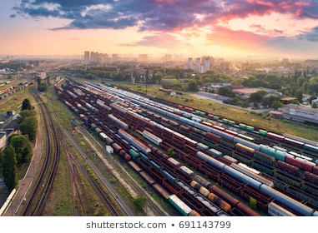
Conclusion
Many systems in railway traffic control need large amount of data to be handled to give information or manage traffic
Helps to predict train traffic flow in real time
Helps to learn the riders journey patterns in the transportation network, which can be used for better public transportation service planning
Helps to increase safety level in railways

Slide 21
References
https://meet.google.com/linkredirect?authuser=0&dest=https%3A%2F%2Fwww.globalrailwayreview.com%2Farticle%2F100714%2Fbig-data-analytics-asset-management-indian-railways%2F
https://meet.google.com/linkredirect?authuser=0&dest=https%3A%2F%2Fwww.researchgate.net%2Fpublication%2F332113402_Prediction_of_Train_Delay_in_Indian_Railways_through_Machine_Learning_Techniques
https://meet.google.com/linkredirect?authuser=0&dest=https%3A%2F%2Fwww.linkedin.com%2Fpulse%2Fdata-science-railway-industry-victor-borges

Slide 22
THANK YOU

